Slide 1

Ergonomics Semester 2 Week 9

Slide 2
What had been discussed last week
Design an algorithm to handle stress, cumulative damage, and risk

Slide 3
Timeline
Content | Date | Progress
Learning Basics of Deep Learning | Sep 2022 | Done
Installing Alphapose/Openpose/VideoPose3D | Sep-Oct 2022 | Done
Learning Ergonomics Basics | Oct-Nov 2022 | Done
Forming a Framework of Time Continuous Cumulative Fatigue
Preparing for Final Exam | Nov-Dec 2022 | Done
Review the Time Continuous Cumulative Fatigue Framework | Dec 2022 | Done
Trying to Extract Coordinates Using Alphapose/Openpose | Dec 2022
Adding on a Cumulative Fatigue Assessment using Alphapose/Openpose with Python | Jan-Mar 2023
Writing a Technical Report for our Research | Mar 2023

Slide 4
How to Obtain Ultimate Strength Percentage, S
Low Back
US_axial = 6000N
US_bending = 51.7 Nm
F
S_bending =
M
S_axial =
US_axial
US_bending
S = a * S_axial + b * S_bending
Shoulder
US_axial = ?
US_bending = ?

Slide 5
How to Obtain Ultimate Strength Percentage, S (Reviewed Version)
Low Back
σ_bending =
My
US_back = 6000N
I
σ_bending * A=
My * A
I
F ’ =
M
a
F + F ’
S =
US_back

Slide 6
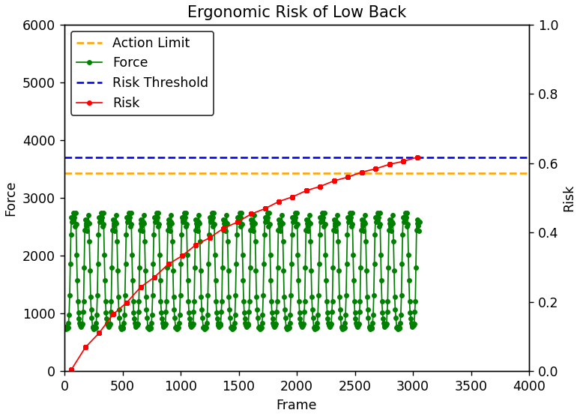
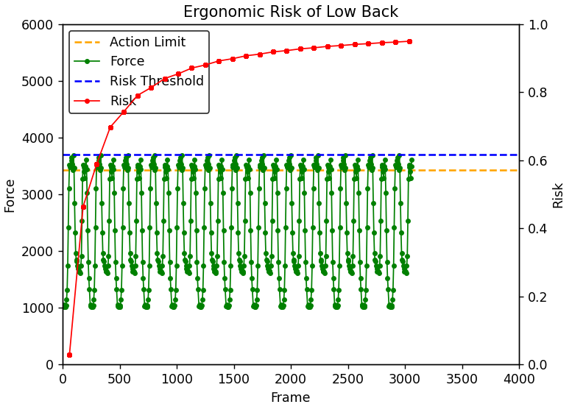
How to Obtain Ultimate Strength Percentage, S (Reviewed Version)
a = 0.1
Body weight = 600N
cd_threshold = 0.3
Load = 50N
a = 0.1
Body Weight = 600N
cd_threshold = 0.3
Load = 250N

Slide 7
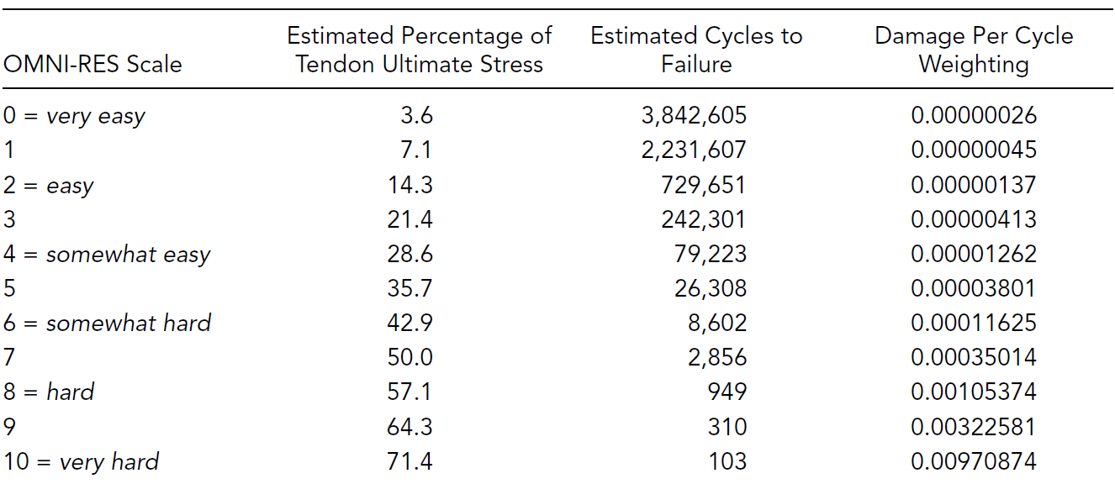
Difficulties for Shoulder Risk
More forces need to be consider (tensile force, compressive force, shear force), each force has different direction.
The current research doesn’t have a golden standard for the maximum acceptable force for all the 3 directions. Current way to deal with shoulder risk is as shown in the figure below, we need to somehow apply a qualitative way (select a category) for the first step
Due to the time limitation and the complexity, I suggest we can just focus on the low back risk at this stage.

Slide 8
Challenges of This Week
Couldn’t find useful information for shoulder

Slide 9
Next Meeting
Research paper (?)

